Slide 1
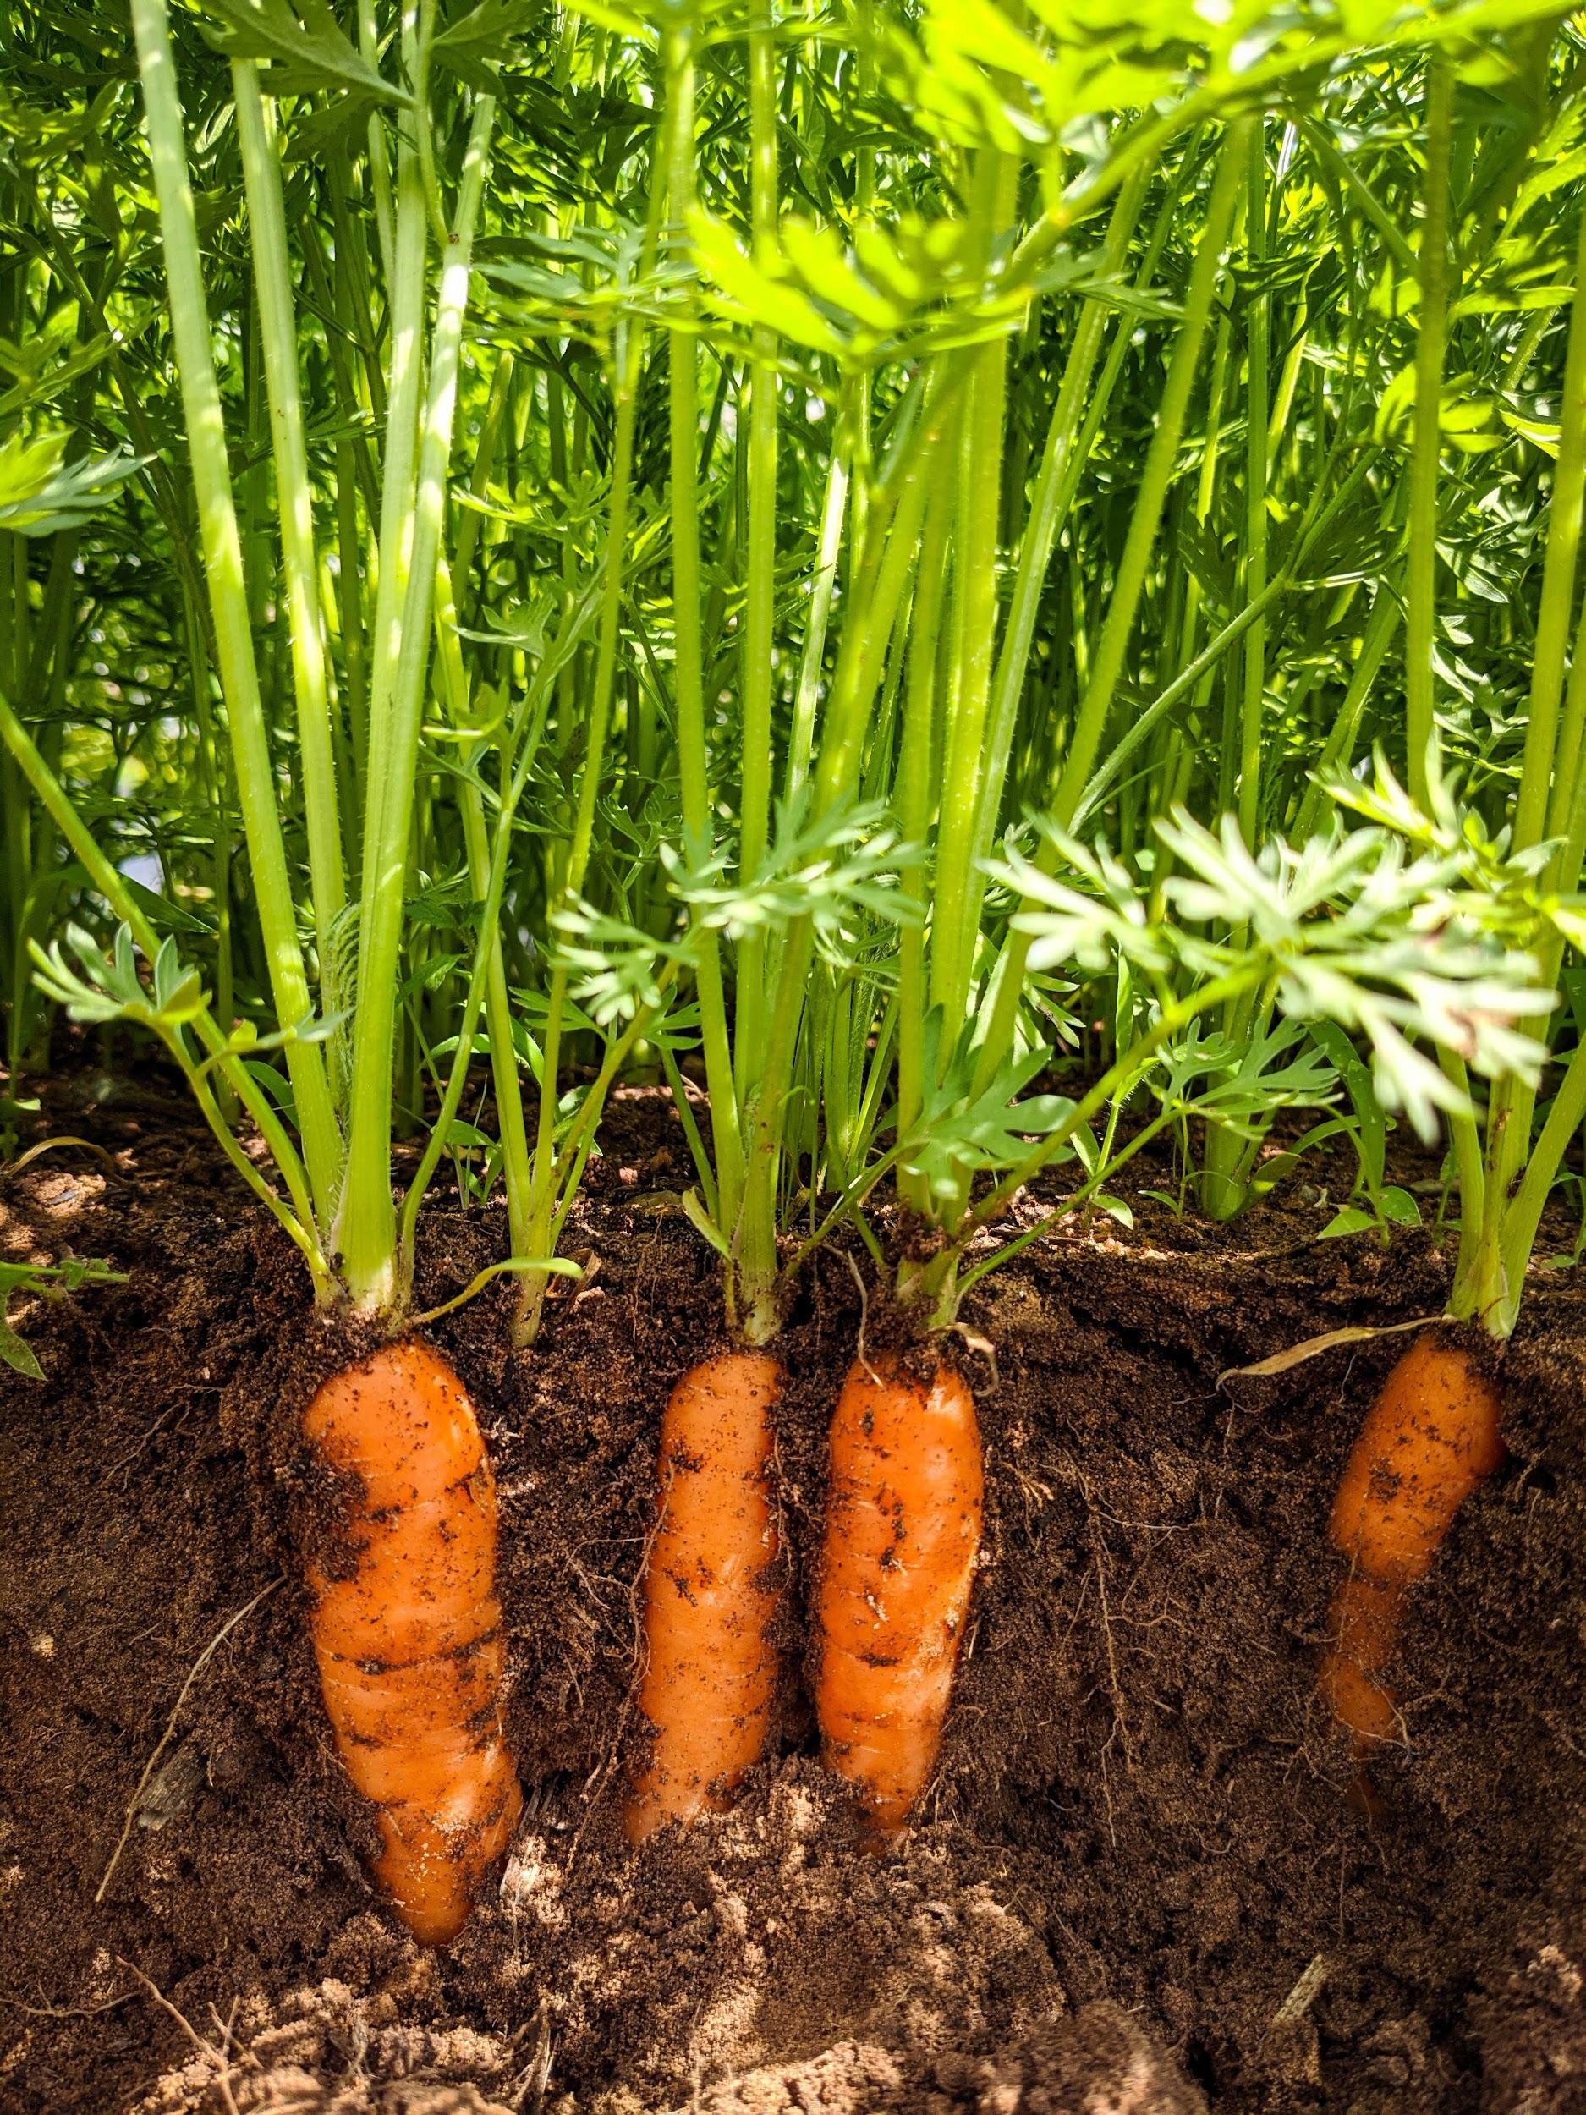
SUSTAINABLE AGRICULTURAL
PRACTICES
Soil Health/Management
Crop Rotation
Cover Crops
Other Growing Methods
Notes:
We want to start by saying that we recognize that the word “sustainable” carries with it a multitude of ideas, and even meanings, depending on the context and especially scale when it comes to agriculture. We are not going to stand here today and tell you THE way to be sustainable… because we believe there are many. We really don’t want to stand here today and TELL you anything… we want to share our experiences but more importantly help facilitate discussions amongst all of you so we can ALL learn together how to better work with the resources we have in a responsible way. You will hear us say that not all techniques will translate perfectly to all scenarios, but please- we want to hear your experience. Even if I can’t use ALL of your suggestions, it may trigger adaptations and ideas that I CAN use to further my farm’s practices toward better practices than I have been using… and that is the goal, right? To always be learning and seeking to improve upon what we are doing right now.
So just for some quick housekeeping… we have an hour and a half here and want to talk about 4 main sub sects of sustainability within that time frame, roughly 20 mins each. Within each of those we want there to be discussion and idea sharing, and also be considering how the ideas can be tied into the business aspect of growing/producing food. Because we have to be able sell our products to be able to continue growing them.

Slide 2
Soil Testing/Management Resources
Local Extension office - www.soiltesting.okstate.edu
Logan Labs- www.loganlabs.com
Midwest Laboratories- www.midwestlabs.com
Ellen Polishuk (consulting)- www.planttoprofit.com/farm-consulting
Beneficial Nematodes- www.arbico.com
Broadfork (locally made!)- Mayfield Metal Works on Facebook
No-Till books: The Organic No Till Farming Revolution, The No Till Organic Vegetable Farm, No-Till Intensive Vegetable Culture, Teaming With Microbes (Fungi, Nutrients)

Slide 3
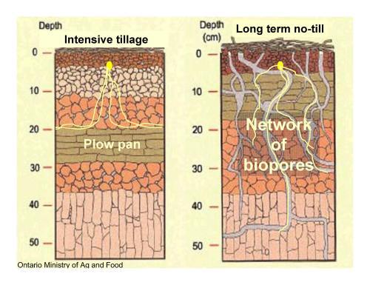
<br class="Apple-interchange-newline"><div></>
Company: The Looney Farm
Job Name: The Looney Farm Date: 10/8/2019
Submitted By:
2 5
Sample Location
Sample ID
Lab Number
Total Exchange Capacity (M. E.)
pH of Soil Sample
Organic Matter, Percent
SULFUR: p.p.m.
Mehlich III Phosphorous:
CALCIUM:
Desired Value
Value Found
Deficit
MAGNESIUM:
Desired Value
Value Found
Deficit
POTASSIUM: Desired Value
Value Found
Deficit
SODIUM:
Calcium (60 to 70%)
Magnesium (10 to 20%)
Potassium (2 to 5%)
Sodium (.5 to 3%)
Other Bases (Variable)
Exchangable Hydrogen (10 to 15%)
Boron (p.p.m.)
Iron (p.p.m.)
Manganese (p.p.m.)
Copper (p.p.m.)
Zinc (p.p.m.)
Aluminum (p.p.m.)
Ammonium (p.p.m.)
Nitrate (p.p.m.)
Sample Depth in inches
lbs / acre
lbs / acre
lbs / acre
lbs / acre
lbs / acre
as (P O )
Chlebnski
Plot 1
69
6
16.05
7.0
3.98
21
1492
4365
4688
462
620
500
741
41
73.03
16.10
5.92
0.56
4.40
0.00
0.81
217
22
1.28
11.67
261
1
43.7
Chlebnski
Plot 2
70
6
9.36
7.1
2.42
18
213
2546
2553
269
488
292
355
41
68.18
21.72
4.86
0.94
4.30
0.00
0.61
183
22
0.76
6.37
324
0.7
16.2
Logan Labs, LLC
Soil Conditions in Till vs. No Till System
Notes:
Another aspect of soil health is the soil composition/tilth. With our heavy clay content in most of Oklahoma, the action of repeated tilling can have long lasting ill effects. Not only does it encourage rhizome regrowth (bermuda and crab grass) but it creates hard pan layer that increases water run off and leads to loss of nutrients and top soil.
- All tilling isn’t bad- most ground will need an initial till to prepare seed bed. After that, using variety of tools as an option for “opening” the soil can be used depending on scale
- subsoiler/ripper (“cuts” vertically into soil without turning it over
- roller crimper (for crop termination at large scale)
- no till drill for seeding large scale
- broadfork
- flail mower (crop termination small scale)
- cover crops
- power harrows/tilthers
The soil can heal itself...how we assist it in that process will vary depending on factors we’ve mentioned repeatedly- scale, business model, time frame available.

Slide 4
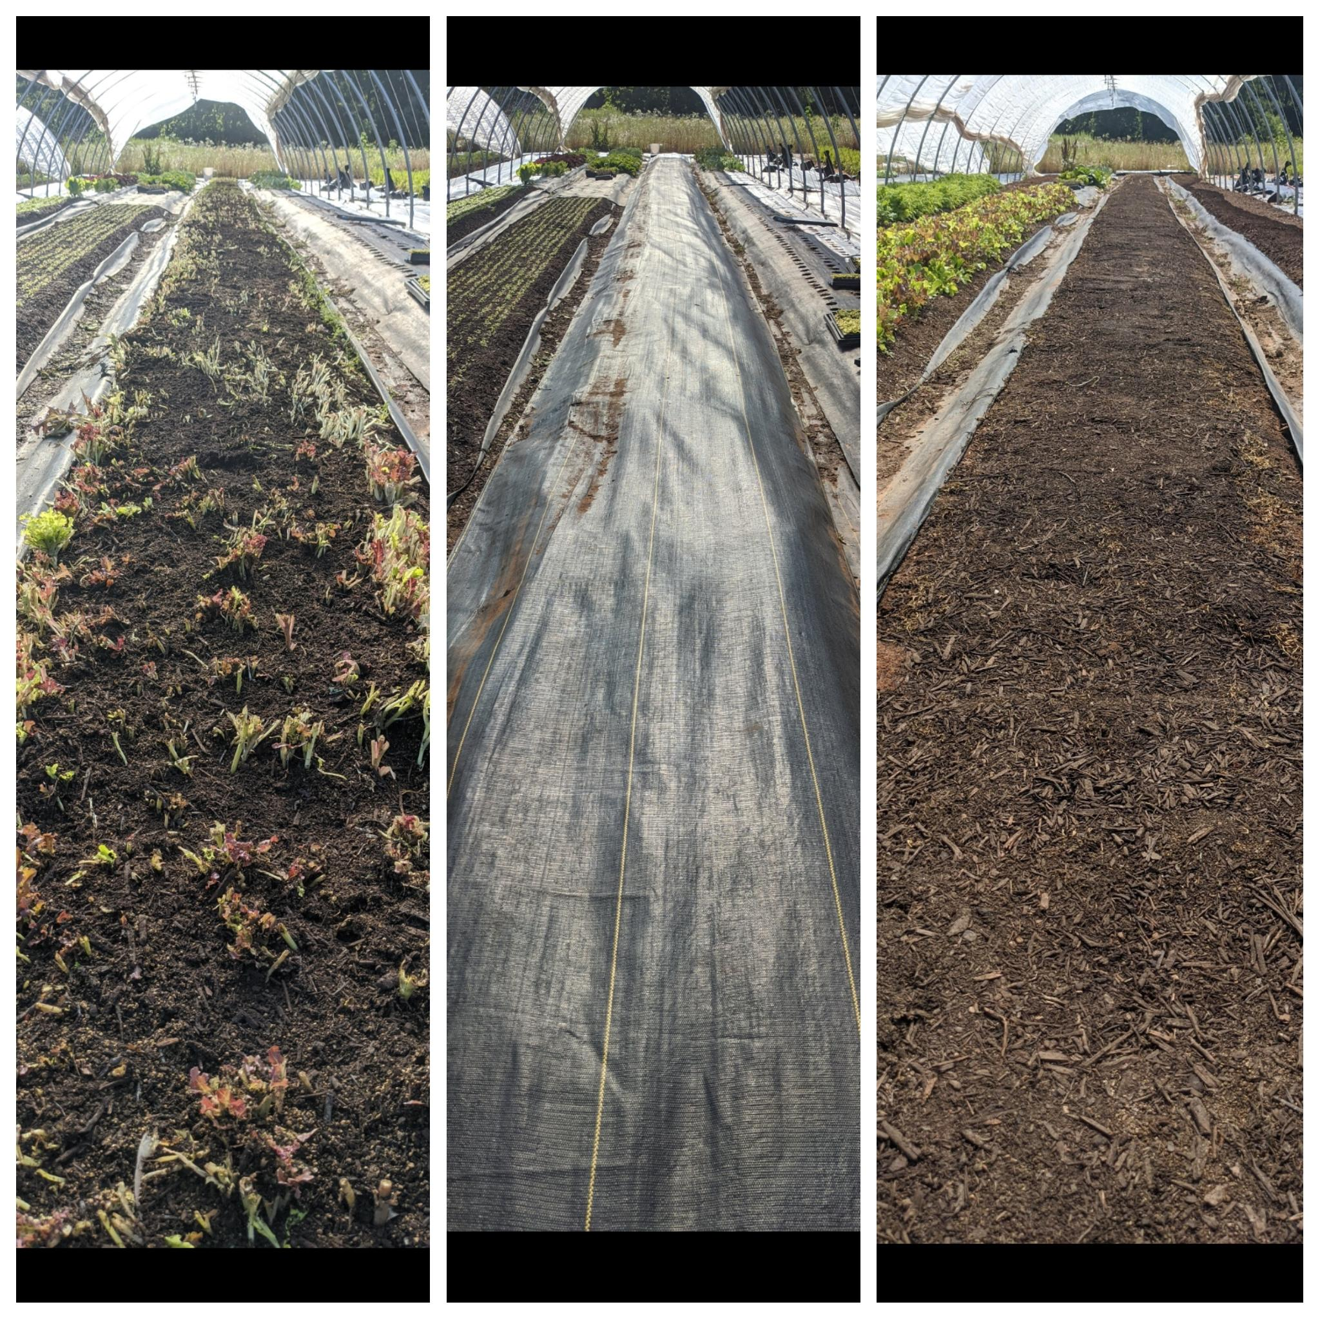
No- Till Bed Flip
Harvest crop/flail mow
Apply compost and amendments
Water well (overhead or drip)
Cover 10-14 days (tarp or fabric)
Uncover and sow/transplant new crop
*worth mentioning:
Works better in heat of season
We prefer the fabric as it allows better moisture permeation during the covered time
Some bed may still require broadforking to loosen soil for transplanting

Slide 5
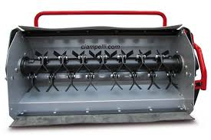
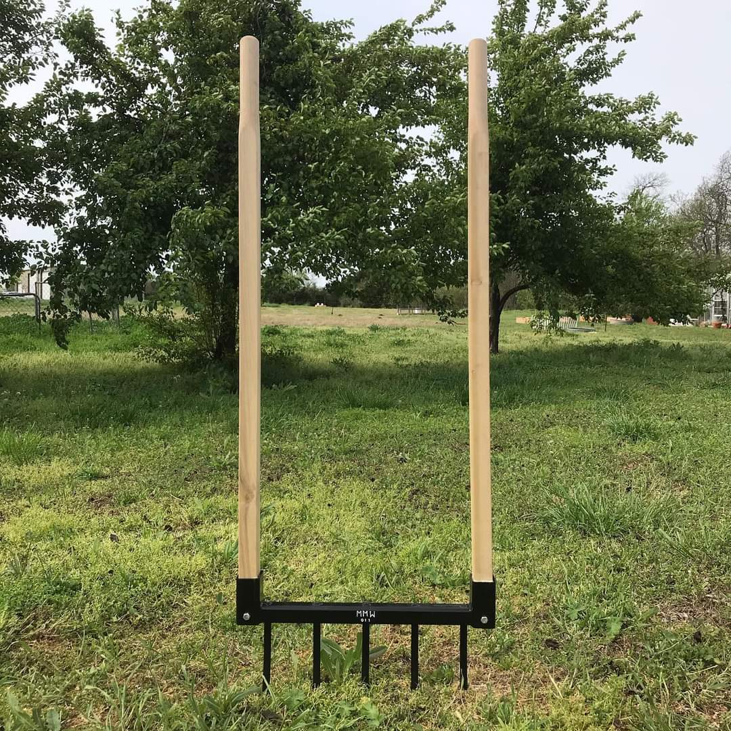
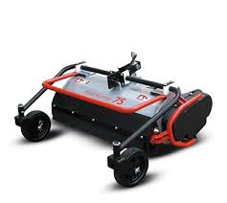

Slide 6
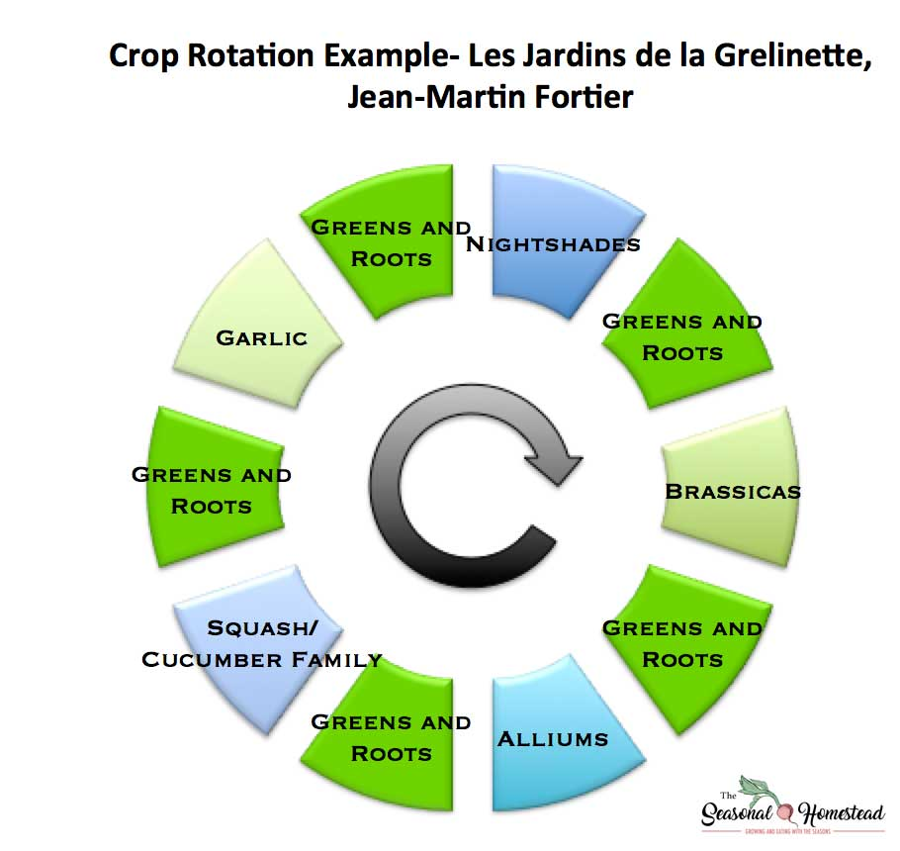
Crop
Rotation

Slide 7
6 | 7 | 8 | 9
arugula | RR/mustard | turnip/radish | radish/fennel
 |  |  | /crop/prep
crop/prep | crop/prep
salanova | spinach | heads/ | rosie/ blk sum
 |  | /heads
crop/prep |  | /crop/prep | crop/prep
fennel ?? |  | crop/prep/
Micro-rotations for Market Gardening
Since we grow on small scale (½ acre), we struggle with growing in large blocks and instead will only have one bed per crop, often in successions. So instead of single rotations per season, we rotate through crops multiple times on single bed plantings.
The goal is to not have the same crop in a bed twice in a row, but other than that we don’t stress too much…we just work that much harder on building healthy soil through compost, amendments and beneficial nematodes….for now

Slide 8
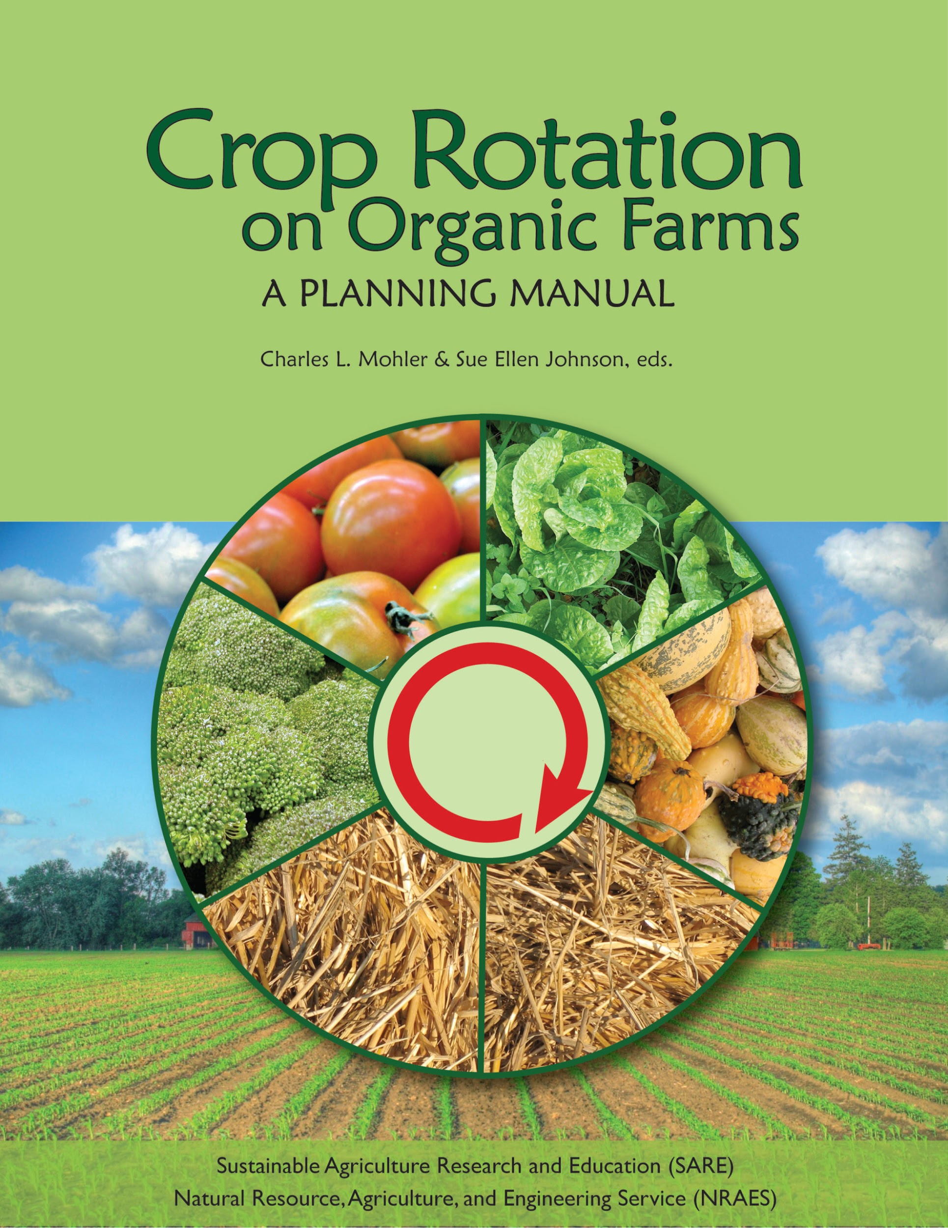
Notes:
This manual can be used in several ways. First, it can be used simply as a reference. For example, one can check for possible pest or soil problems that may occur in a cropping sequence, or determine how long to leave a field out of a particular crop to avoid pest problems. Second, the manual can be used to see how experienced growers think about crop rotations, and how they manage particular crop sequences on their farms. Reading about what researchers have discovered about how crop rotation affects soil and pests will further increase one’s understanding of crop rotations. Finally, the manual provides a method for systematically planning the crop rotations on a farm.

Slide 9
Ten Most Important Tasks
1. Maintain crops.
2. Implement production plan.
3. Prepare soils as soon as weather permits.
4. Plant crops.
5. Walk fields regularly to observe crops and fields.
6. Review overall farm operation.
7. Draft annual [rotation] plans.
8. Monitor soil and crop conditions.
9. Adjust actions according to field and crop conditions.
10. Identify problems that can be addressed through rotation.

Slide 10
Ten Most Difficult Tasks
1. Assess profitability on a whole-farm and crop-by-crop basis.
2. Maintain crops.
3. Assess whether pest, disease, and weed pressures must be addressed.
4. Investigate new market opportunities.
5. Review overall farm operation.
6. Review regulations.
7. Analyze weather probabilities.
8. Determine if successes or failures were due to on-farm or regional factors.
9. Develop collaborations to verify successes and solve problems.
10. Tweak the crop mix.

Slide 11
Goals for Crop Rotation
1. Maintain healthy soil (including chemical
balance, drainage, humus, vitality, biological
health, fertility, nutrient cycling, tilth,
organic matter, and soil cover to prevent
erosion); for example: “Conserve and build
organic matter in my light sandy soil.”
2. Produce nutritious food.
3. Control diseases, especially soilborne
diseases; for example, “Break the wilt cycle
among crops in the tomato family.”
4. Reduce weed pressure; for example,
“Manage the rotation to confuse the weeds.”
5. Increase profitability.
6. Have a holistic approach and a good rotation
that leads to healthy crops.
7. Manage the farm as a whole system.
8. Have a diverse line of products to market.
9. Provide economic stability.
10. Control insects.
11. Add nitrogen and other nutrients in a way
that is environmentally safe and conforms
with regulations.
12. Maintain biotic diversity.
13. Unlock the living potential of the soil.
14. Reduce labor costs.
15. Balance economic viability and soil fertility.
16. Diversify tasks to keep labor happy and
productive all season.
17. Balance the needs of the farm with the needs of the farmer.
18. Minimize off-farm inputs.
19. Capture solar energy wherever possible.
20. Refine the aesthetic quality of fields and
farm.
21. Bring the farmer to life; develop a spiritual
relationship with the land.

Slide 12
Questions or comments?

Slide 13
SUSTAINABLE AGRICULTURAL PRACTICES
Cover Crops
Other Growing Methods

Slide 14
Why Cover Crops?
What is a cover crop
A cover crop is a plant that is used primarily to slow erosion, improve soil health, enhance water availability, smother weeds, help control pests and diseases, increase biodiversity and bring a host of other benefits to your farm.
Basic principals of soil health
Cover the Soil.
Minimize Soil Disturbance.
Increase Plant Diversity.
Maintain Continuous Living Plants/Roots.

Slide 15
Benefits of Cover cropping
Soil health
Increase Organic Material
Feeds the soil
Increase ability to retain water
Disease management
Fertility
Weed suppression
Companion planting for pest management
Living mulch
Pollinators

Slide 18
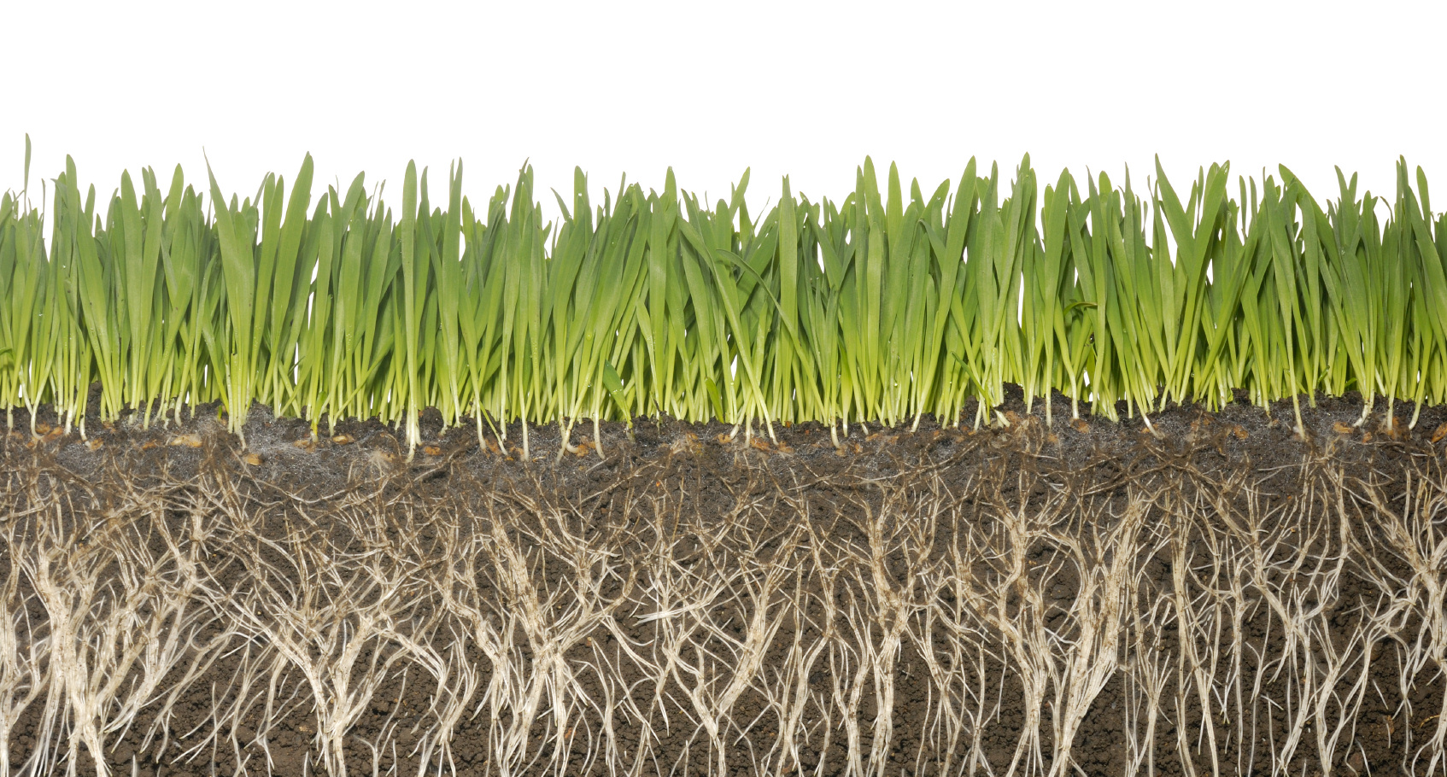

Slide 19
Management of cover crops
Planting
Terminating
What to do after terminating

Slide 20
Planting methods of cover crops
Broadcasting
Easiest method
Can be broadcast into unworked soil and into existing crops
Less effective – requires more seed
Germination can be improved significantly by working in seed with raking or harrowing, also by preparing a seed bed ahead of time
Machine method
Drills on tractors for larger fields
Jang seeder or other small field seeder

Slide 21
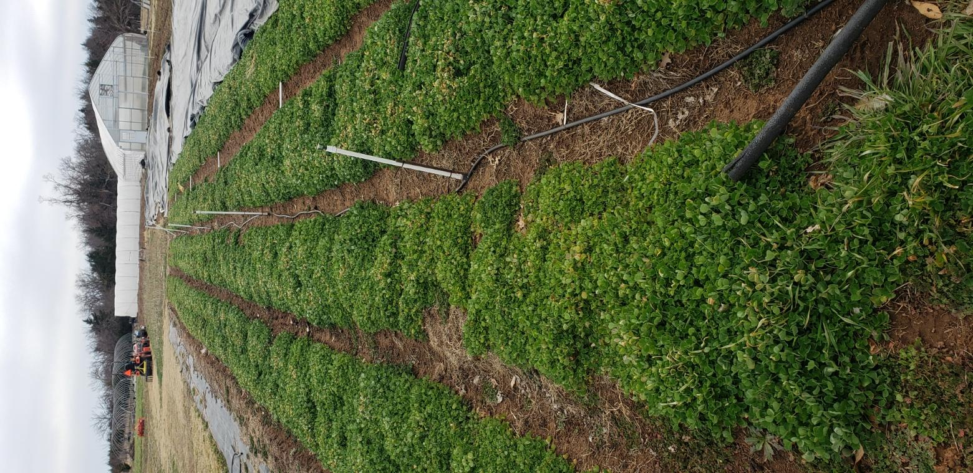

Slide 22
Terminating cover crops
Mowing
Flail movers preferred – BCS or tractor
Weed eaters (small gardens)
Crimping method - mechanical
Winter freeze
Chemical use – not recommended for soil health

Slide 23
What to do after terminating cover crops
Nothing – leave on top of soil as a mulch, roots in the ground
Till or plow to work soil into ground
Use mechanical means to layer soil onto to create raised beds
Rake up mulch and move to existing beds or compost piles
Cover with tarp to speed up decomposition
Plant directly into mulch

Slide 24
Cover crops
What to plant and when?

Slide 25
Cover crops - What to plant and when?
Soil needs:
Fertility
Nitrogen – Alfalfa, peas, beans, clovers
Phosphorous - Some covers, such as buckwheat and lupins
Add crops that increases mycorrhizae – increases hyphae
Potassium – Green manures, tubers, chicory
Compaction
Sunflower, okra, Sorghum-sudan grass
Organic matter
Grasses (rye), clovers, tubers – Sorghum-sudan
Weed suppression
Buckwheat, sorghum-sudan – any thick fast growing crop
Disease
Mustards, brassicas

Slide 26
Cover crops - What to plant and when?
Seasonal planting guide – examples:
Early spring
Oats/Peas
Barley
mustards and annual ryegrass
Summer
Buck wheat
Sunflower
Sorghum Sudan
Peas – cowpeas
Fall/Winter
Radishes
Clover
Rye
Wheat
Vetch

Slide 27
Have a cover crop strategy
Here’s what we do:
All new plots get covered cropped for full year
Spring planting
2 summer plants
Fall/Winter planting
Any bed that sits ideal for 3 or more weeks gets buckwheat planted, flail mowed, tarped
All plots will go ideal once every 6 years and will get a full year of cover crops

Slide 28
Other Growing Methods
Protected Agriculture
High tunnels
Portable hoop houses or caterpillar tunnels

Slide 29
Protected Agriculture
Natural benefits for soil health
Reduced erosion
Warmer soil in offseason
Lack of surface crusting from rainfall
Cover cropping can be difficult – Find time to plant in HT
Consider living mulches on long season crops
Clovers
Annual rye grasses
Also use cut cover crops from outside used as mulch

Slide 30
Protected Agriculture
Be Aware of These Things When Using a Living Mulch
As with most things, there are a few downsides to using a living mulch.
1. Competition: Though living mulches can help reduce competition from weeds, they can themselves created added competition for crop plants. Keep them regularly mowed, if necessary, and make sure they don’t restrict air and water movement around your plants.
2. Smothering: Don’t use living mulches around very shallow-rooted plants.
3. Overzealous Reseeding: Some types of living mulches reseed prolifically, if they’re allowed to fully mature. As with cover crops, pay attention to the maturity of your living mulches and keep them mowed accordingly.
4. Disease Encouragement: In some cases, particularly in high tunnels, a stand of living mulch can restrict air movement around crops. This may encourage certain fungal pathogens so care should be taken to ensure the living mulches don’t crowd against crop foliage.

Slide 31
Portable hoop houses or caterpillar tunnels
Can disassemble, relocated and then plant cover crops in existing plot

Slide 32
Questions or comments?

